Slide 1

Learn. Imagine. Build.
{user group name} welcomes….
.NET Conf Virtual event | Sept 19-21, 2017
Watch the recorded sessions and attend
.NET Conf local events happening in a city near you.
www.dotnetconf.net

Slide 2
.NET Core 2.0 Released Aug. 14
Download: www.dot.net/core
Announcement: aka.ms/dotnetcore2announce
Launch video: aka.ms/dotnetcore2launchvideo
GO!!!!!!!!!!!!!!
Notes:
Thank you for coming out to the local chapter of .NET Conf!!! If you haven’t heard, .NET Core 2.0 released on August 14th --- what are you waiting for?
GO GET IT!
I’m going to talk a bit about what .NET Core 2.0 is all about as well as what .NET Standard 2.0 brings to the ecosystem……

Slide 3
Visual Studio 2017 Version 15.3 &
Visual Studio for Mac 7.1
Download today!
www.visualstudio.com
Notes:
Oh,,, before I do that… I should mention that .NET Core is so much better with Visual Studio --- now also available on the Mac! Lot’s of improvements and new features you’re going to need with .NET Core 2.0 development.

Slide 4
.NET: Major Investment Areas
TRADITIONAL EXPERIENCES
Windows desktop and server applications
.NET FRAMEWORK
.NET
Standard
Modern CLOUD EXPERIENCES
OSS .NET for modular, Enterprise-ready microservices
.NET CORE
MODERN DEVICE EXPERIENCES
Only platform providing native, cross-plat experiences
UWP
mono (XAMARIN & UNITY)
Notes:
OK Let’s talk about .NET as an entire development experience and where and how Microsoft is investing….
Microsoft will continue to invest in the .NET Framework but with a much higher compatibility bar. As a component of Windows, we have over 1.8 Billion installations on Windows and take this very seriously. Critical bug fixes and low impact or critical features will be added but not at a fast pace. We want to keep the apps you have running.
.NET Core is our newest, fastest, cross-platform, open source implementation of .NET that will take us to the next 15 years. It is built for cloud-native and small device workloads that can be deployed with the app in a small container. .NET Core is where Microsoft innovates quickly with the us, the community, in the open on GitHub. This is the nature of open source. Because .NET Core is cross-platform (Windows, macOS, multiple distros of Linux), we’ve decoupled .NET Core support policy from the operating system. We take a model of Long-Term-Support (LTS) on major versions for 3 years.
Now with Mono officially under the Microsoft umbrella as well as Universal Windows Platform, we are all are focused on fantastic experiences for mobile devices. You will see innovation from Windows (and Unity for Hololens for instance) as well as iOS an Android solutions with Xamarin. And a huge number of OSS community projects in these spaces.
As we bring .NET everywhere we focus on these implementations. .NET standard is what brings these implementations closer together. Think of it as the “new base class libraries” which you build upon and can reuse the binaries in other runtimes that implement the standard. All runtimes supported by Microsoft implement the standard (.NET Framework, .NET Core, Mono).

Slide 5
.NET Standard brings it all together
MODERN APPS
.NET Standard allows sharing code, binaries and skills between .NET client, server and all of its flavors.
.NET Standard provides a specification for any platform to implement (conceptually similar to HTML)
All .NET runtimes provided by Microsoft are implementing the standard
TRADITIONAL WINDOWS
CLOUD MICROSERVICES
WINDOWS 10
IOS, ANDROID
GAMES / 3D
.NET STANDARD
LIBRARIES
INFRASTRUCTURE
COMPILERS
LANGUAGES
RUNTIME COMPONENTS
Notes:
When we talk about .NET we’re talking about an entire unified platform and ecosystem. Any workload on .NET supports .NET Standard going forward. With Mono now under the .NET Foundation we can steer the direction of all of these implementations more easily. Each .NET implementation be that .NET Framework, .NET Core, or Mono for Xamarin & Unity, share the same common infrastructure and .NET Standard library. This means not only are your .NET skills portable, but your actual binaries are portable across implementations.
You can think of the .NET Standard to HTML5 – it’s a specification of HTML that browsers must implement. Similarly, the .NET Standard defines the API’s that all the .NET’s must implement. This is the promise of .NET Everywhere.
See: https://docs.microsoft.com/en-us/dotnet/articles/standard/components

Slide 6
.NET Standard 2.0
Has much bigger API surface
Extended to cover intersection between .NET Framework and Xamarin
Also makes .NET Core 2.0 bigger as it implements .NET Standard 2.0
+20K
More APIs than
.NET Standard 1.x
Can reference .NET Framework libraries
Compatibility shim allows referencing existing .NET Framework binaries
No recompile required – also covers existing NuGet packages
Limited to libraries that only use APIs that are available for .NET Standard
~70%
of NuGet packages
are API compatible

Slide 7
.NET Core 2.0
Fastest version of .NET ever
More APIs
More project templates
More distros
Simplified packaging
New and improved Visual Studio tooling
Visual Studio for Mac support

Slide 8
ASP.NET Core 2.0
Faster
Razor Pages
Razor support for C# 7.1
Azure Diagnostics & Live Analytics
Angular and React templates
Authenticator app support in templates

Slide 9
Visual Studio 2017 (starting in version 15.3)
Support for .NET Core 2.0 and .NET Standard 2.0
Simplified and portable project files across CLI & Visual Studio family
Code navigation improvements
Live Unit Testing supported for .NET Core projects
Visual Studio tools for C# Azure Functions in box
CI/CD support for containers
Notes:
Visual Studio 2017 now supports creating and running .NET Core 2.0 apps, just remember the SDK does not yet come as part of Visual Studio 2017, so you will need to download and install the .NET Core 2.0 SDK separately.
With the added support for .NET Core 2.0 in Visual Studio 2017 you can create .NET Core web and console applications, and .NET Core and .NET Standard class libraries using Visual Basic as well as C#
NET Framework and .NET Standard/Core interop: Users can now more seamlessly install or refer to .NET Core/.NET Standard libraries from .NET Framework projects and vice versa. No need to manually add interop NuGet packages – system does this for you automatically.
Build: Incremental builds for .NET Core is now turned ON by default.
LUT
maintain quality and test coverage of your .NET Core apps and libraries during rapid development. See the results of your unit tests as you code to
Automatically execute impacted tests as you edit code and get real-time visual feedback on the test results. Ensure that your changes do not break the tests, simply by changing your code!
Live Unit Testing updates each line of code in the Visual Studio editor to show you whether the code you're writing is covered by unit tests and whether the tests that cover it are passing. See where you are missing tests to quickly decide which tests to create next.
AZURE FUNCTIONS
Visual Studio Tools for Azure Functions are now included as part of the Visual Studio installation. To get the tools, you need to make sure to install the Azure workload.
Create pre-compiled C# functions that provide better cold start performance than script based functions, and opens the entire eco-system of Visual Studio tools for class libraries including code analysis, unit testing, complete IntelliSense, 3rd party extensions, etc
Use WebJobs attributes to declare function bindings directly in the C# code rather than the separate function.json file

Slide 10
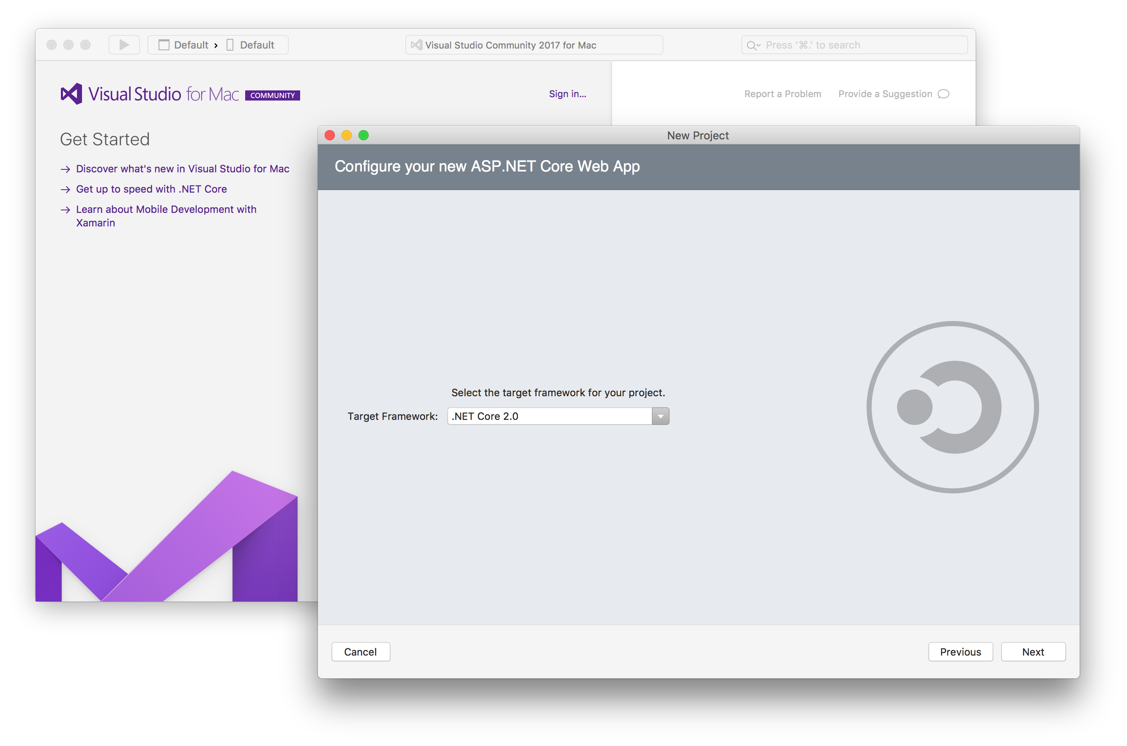
Visual Studio for Mac & .NET Core (7.1 +)
.NET Core 2.0 support
Console
Web App
Web API
.NET Standard libraries

Slide 11



Key Takeaways
API
.NET Standard 2.0
Performance
Visual Studio Tools
Expanded API surface area allows much more of your code and binaries to be shared across all .NET runtimes and workloads
.NET Core 2.0 is the fastest version of .NET ever
Visual Studio and Visual Studio for Mac latest updates fully support .NET Core 2.0

Slide 12
.NET

